Slide 1
Kanban Dashboard
A Task Management Solution

Slide 2
Introduction
The Kanban Dashboard is a visually intuitive task management application inspired by the Kanban methodology. It enables users to efficiently organize, prioritize, and manage tasks through a card-based layout, categorizing tasks into columns such as 'To Do,' 'In Progress,' and 'Done.'

Slide 3
Key Features
- User-friendly interface
- Secure user authentication
- Dynamic drag-and-drop functionality
- Task creation, updating, and deletion
- Backend integration for data persistence

Slide 4
Project Objectives
- Create a responsive and intuitive interface
- Implement secure authentication
- Enable drag-and-drop task updates
- Provide real-time task management
- Store and retrieve task data efficiently

Slide 5
Objective 1: Responsive Interface
- Intuitive design and navigation
- Visual clarity with categorized columns
- Compatibility across devices
- Clean and clutter-free layout

Slide 6
Objective 2: Secure Authentication
- User registration and login
- Token-based session management
- Data privacy and security
- Clear error handling for invalid credentials

Slide 7
Objective 3: Drag-and-Drop Functionality
- Update task status with drag-and-drop
- Real-time updates and feedback
- Smooth transitions for better experience
- Simplifies task management process

Slide 8
Objective 4: Real-Time Task Management
- Add, update, and delete tasks
- Reflect changes immediately on UI
- Validate inputs to prevent errors
- Provide instant feedback for user actions

Slide 9
Objective 5: Backend Integration
- Persist task data in a database
- RESTful APIs for data operations
- Synchronization between UI and server
- Handle errors with fallback mechanisms

Slide 10
User Authentication Flow
1. User registers with unique credentials.
2. Credentials are verified during login.
3. Authenticated sessions are maintained securely.
4. Errors such as invalid login provide user feedback.

Slide 11
Drag-and-Drop Functionality
- Users drag tasks between columns ('To Do,' 'In Progress,' 'Done').
- Tasks update dynamically without page reload.
- Smooth transitions enhance user interaction.

Slide 12
Real-Time Task Management
- Add new tasks using forms.
- Update task details as needed.
- Delete tasks to declutter dashboard.
- Changes are instantly visible on UI.

Slide 13
Data Storage and Retrieval
- Task data is stored in a backend database.
- API endpoints manage CRUD operations.
- Data consistency is maintained.
- Robust error handling for network/server issues.

Slide 14
Benefits of Kanban Dashboard
- Improved task organization and prioritization.
- Enhanced productivity and focus.
- Simplified project tracking and management.
- Accessible and secure task management tool.

Slide 15
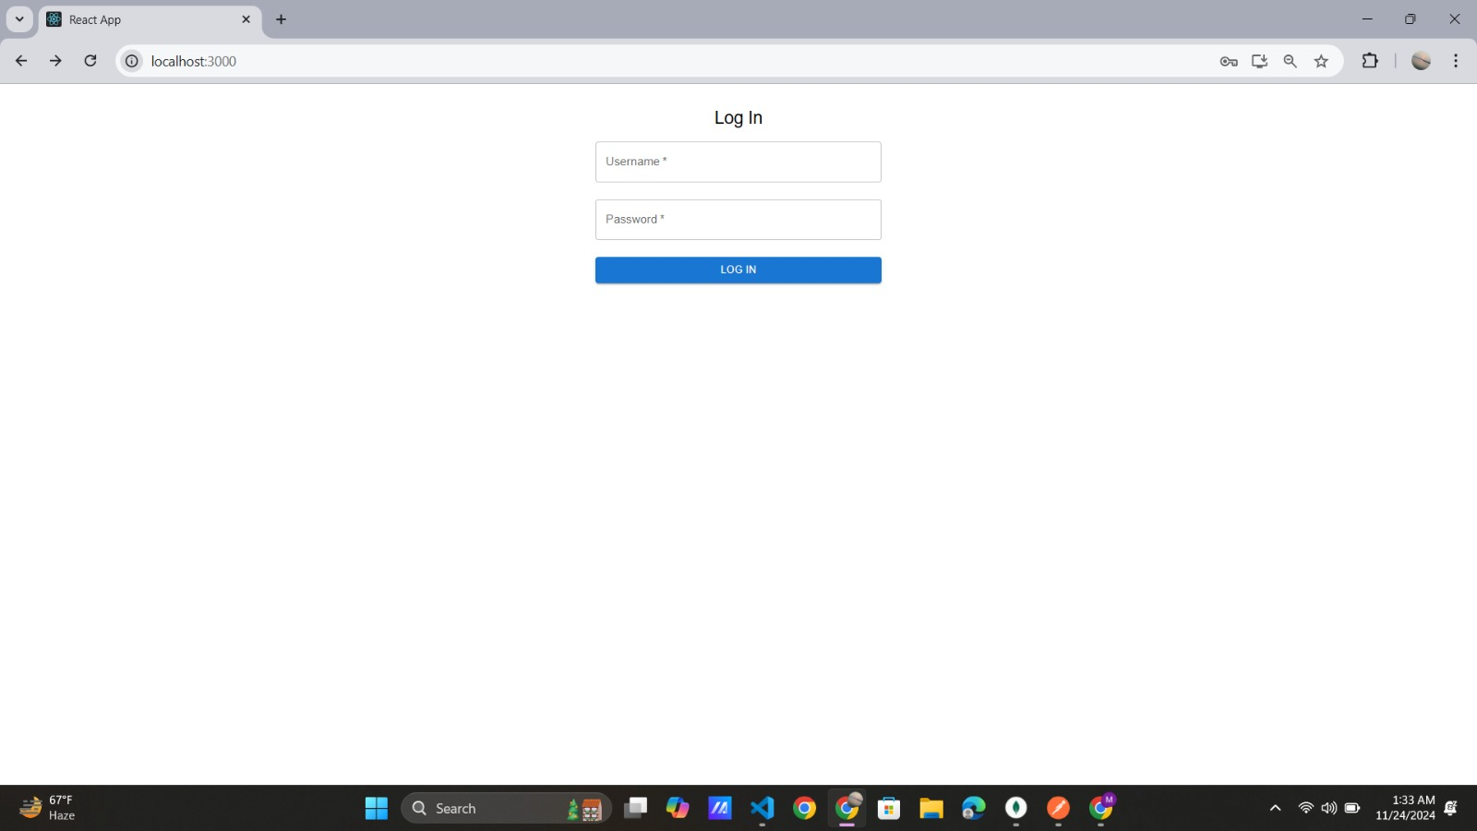

Slide 16
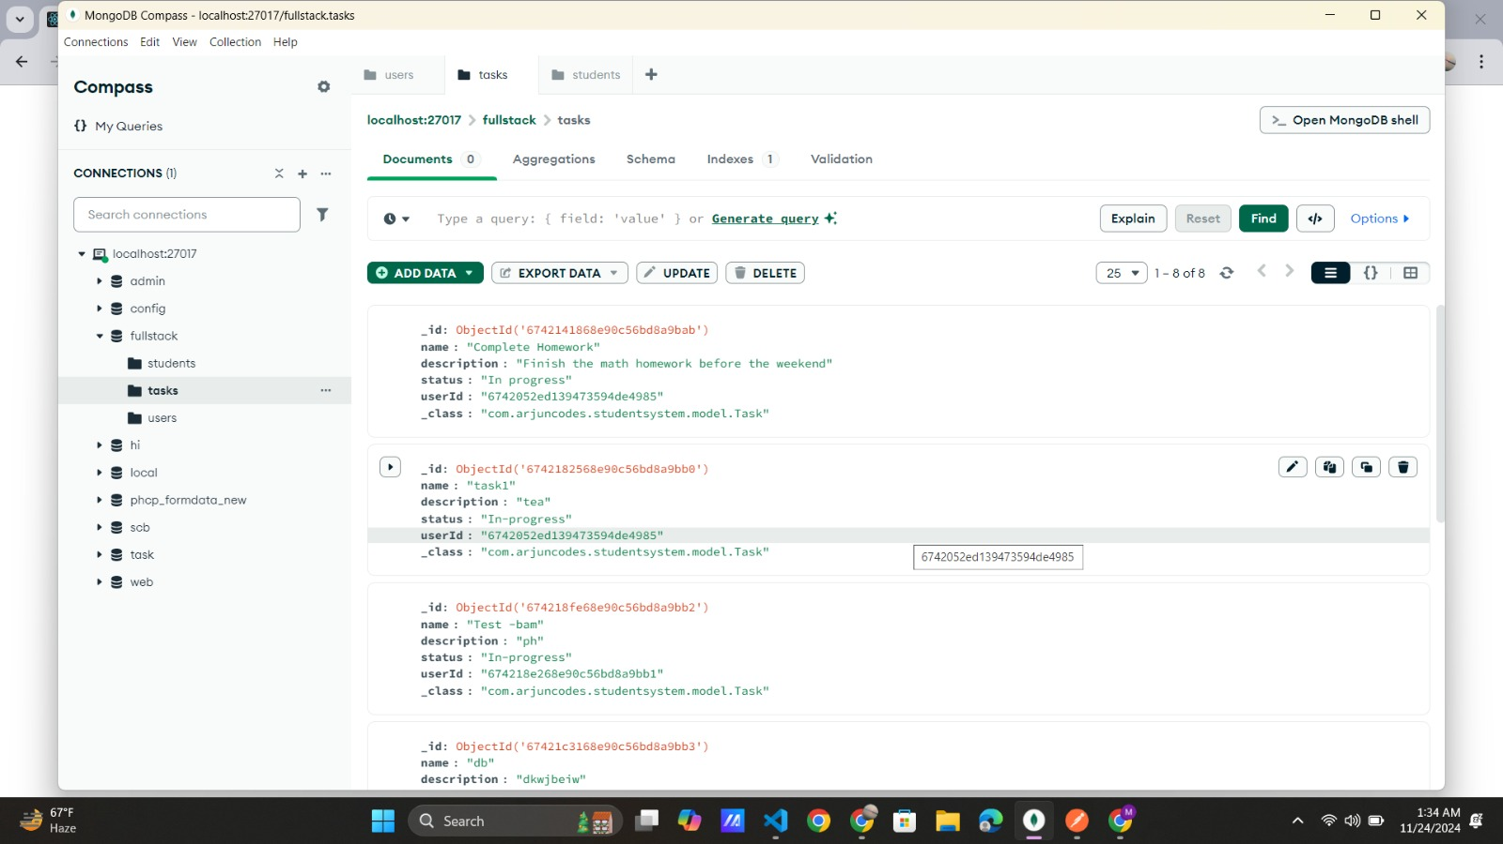

Slide 17
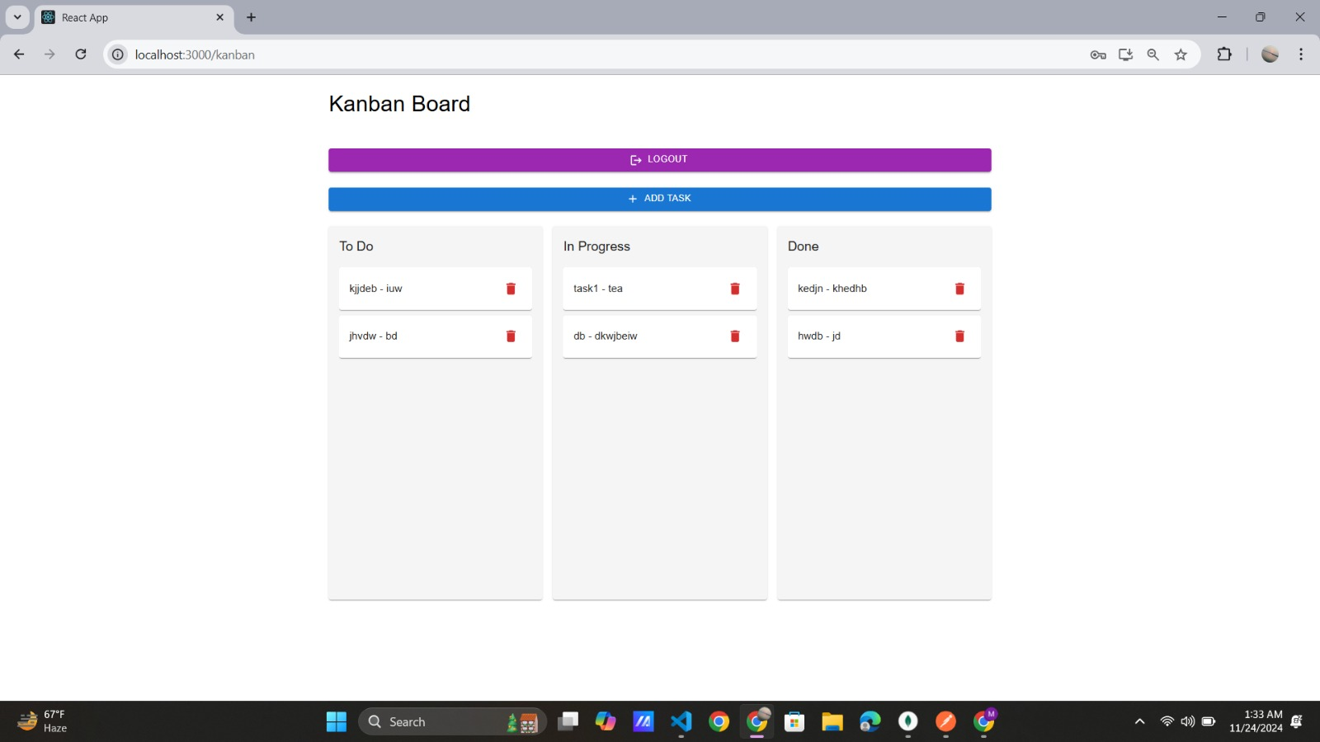

Slide 18
Conclusion
The Kanban Dashboard offers a powerful yet user-friendly solution for managing tasks. Its dynamic features and secure architecture make it an ideal tool for individuals and teams seeking efficiency and organization in their workflows.

